Slide 1
CALM CORNER
Mindfulness
and
Stress Reduction App

Slide 2
Topic Outline
01
02
03
04
05
06
Problem Statement
Solution
Tech stack
Design
Testing
SnapShots

Slide 3


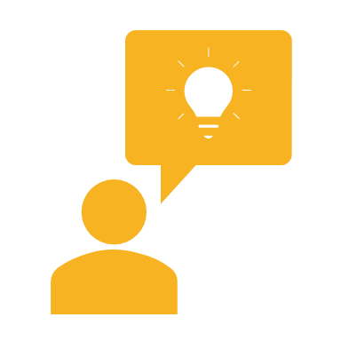
Problem statement
In today's fast-paced digital era, stress and anxiety are widespread issues
The demand for accessible, effective, and user-friendly stress reduction solutions is greater than ever.
Research indicates that mindfulness practices can greatly enhance mental well-being.

Slide 4

Solution
Calm Corner: is not just an app; it's a commitment to promoting mental well-being.
It offers an escape for users to find solace reduce stress and promote their mental health at their fingertips.
It acts as a digital oasis in this modern world.
The app's cross-platform compatibility, beautiful user interfaces, and swift development make it accessible and visually stunning.
It's backed by a robust tech stack and a supportive Flutter community.

Slide 5
Tech stack : Flutter
Cross-platform compatibility
Beautiful user interfaces
Swift development
Robust performance
Supportive community

Slide 6
User-centric Design
Deep Commitment to Users: Profound emphasis on prioritizing the needs of our users
Accessibility for All: Regardless of the user’s technological background, the app is user-friendly
Seamless User Experience: Users can easily move through the app, discovering a wide range of mindfulness exercises, participating in stress reduction techniques, and receiving daily affirmations without any friction.
A Digital Oasis: It's designed to help users find solace and enhance their mental well-being.
General Requirements :
Include inputs such as user preferences and stress levels, and
Outputs like tailored mindfulness exercises and daily affirmations.

Slide 7
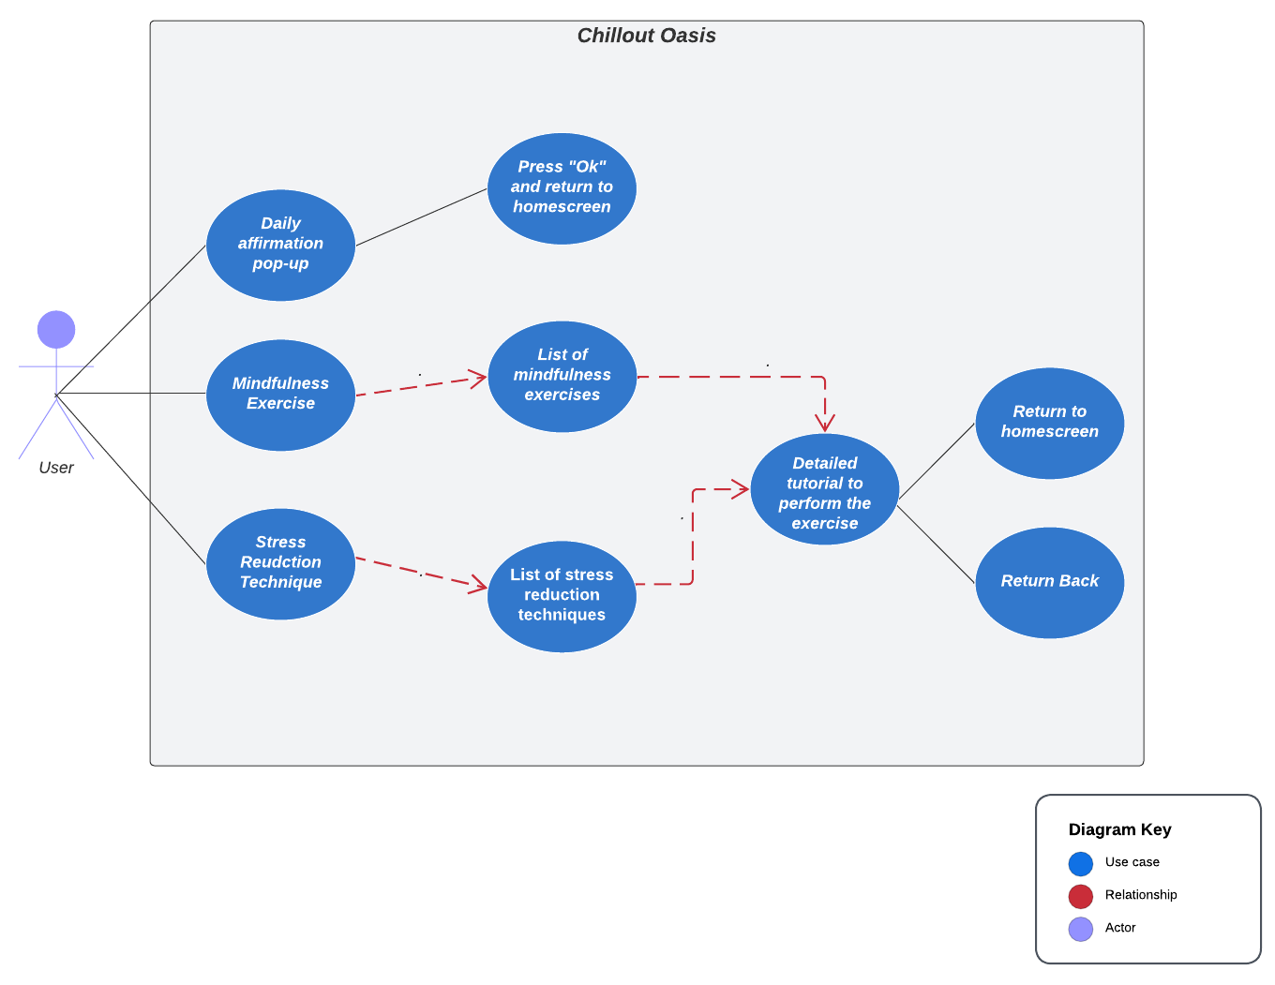
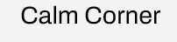
UML Diagram
Calm Corner

Slide 8
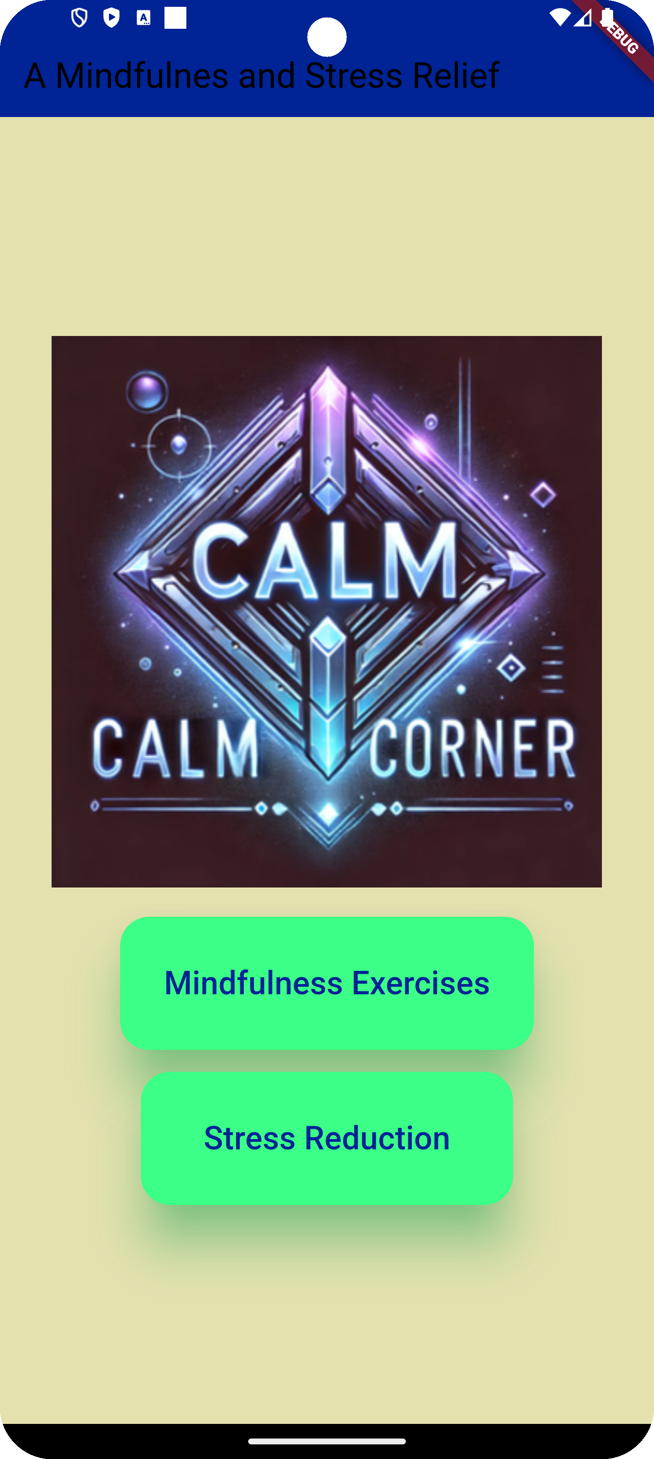
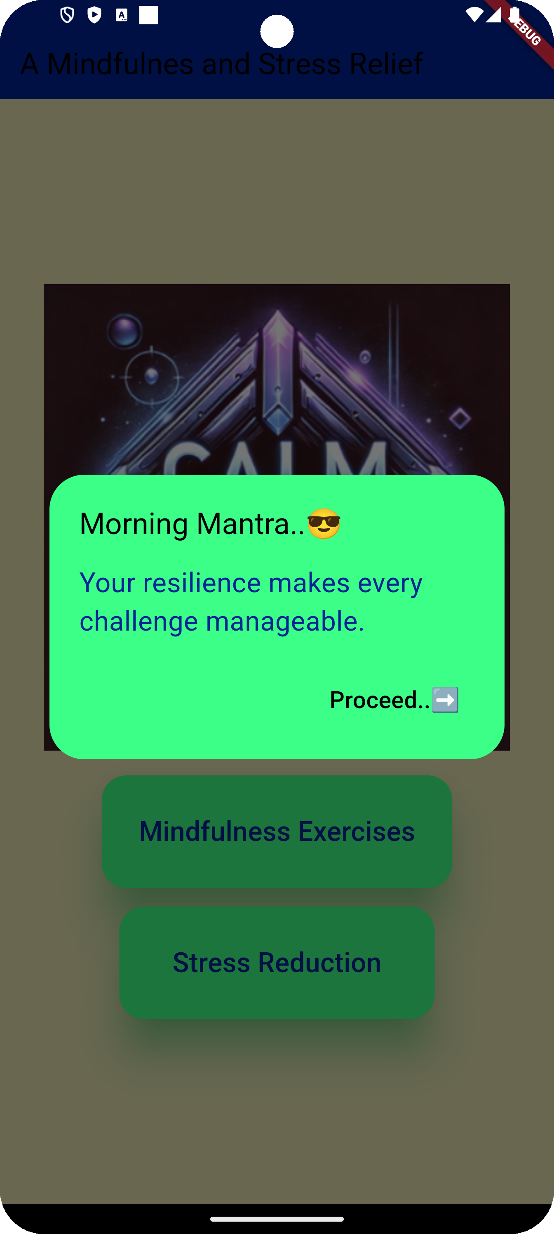
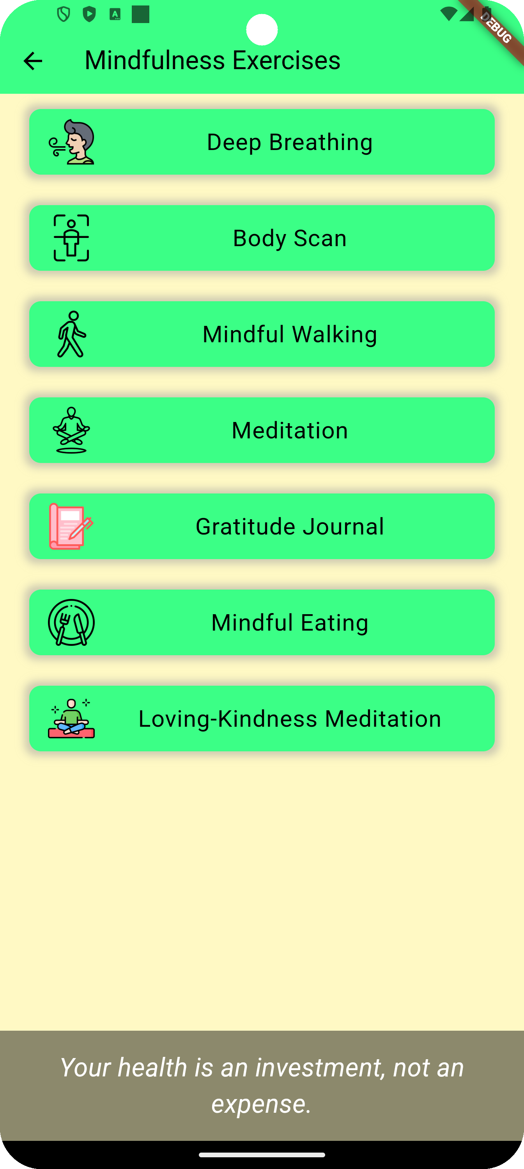
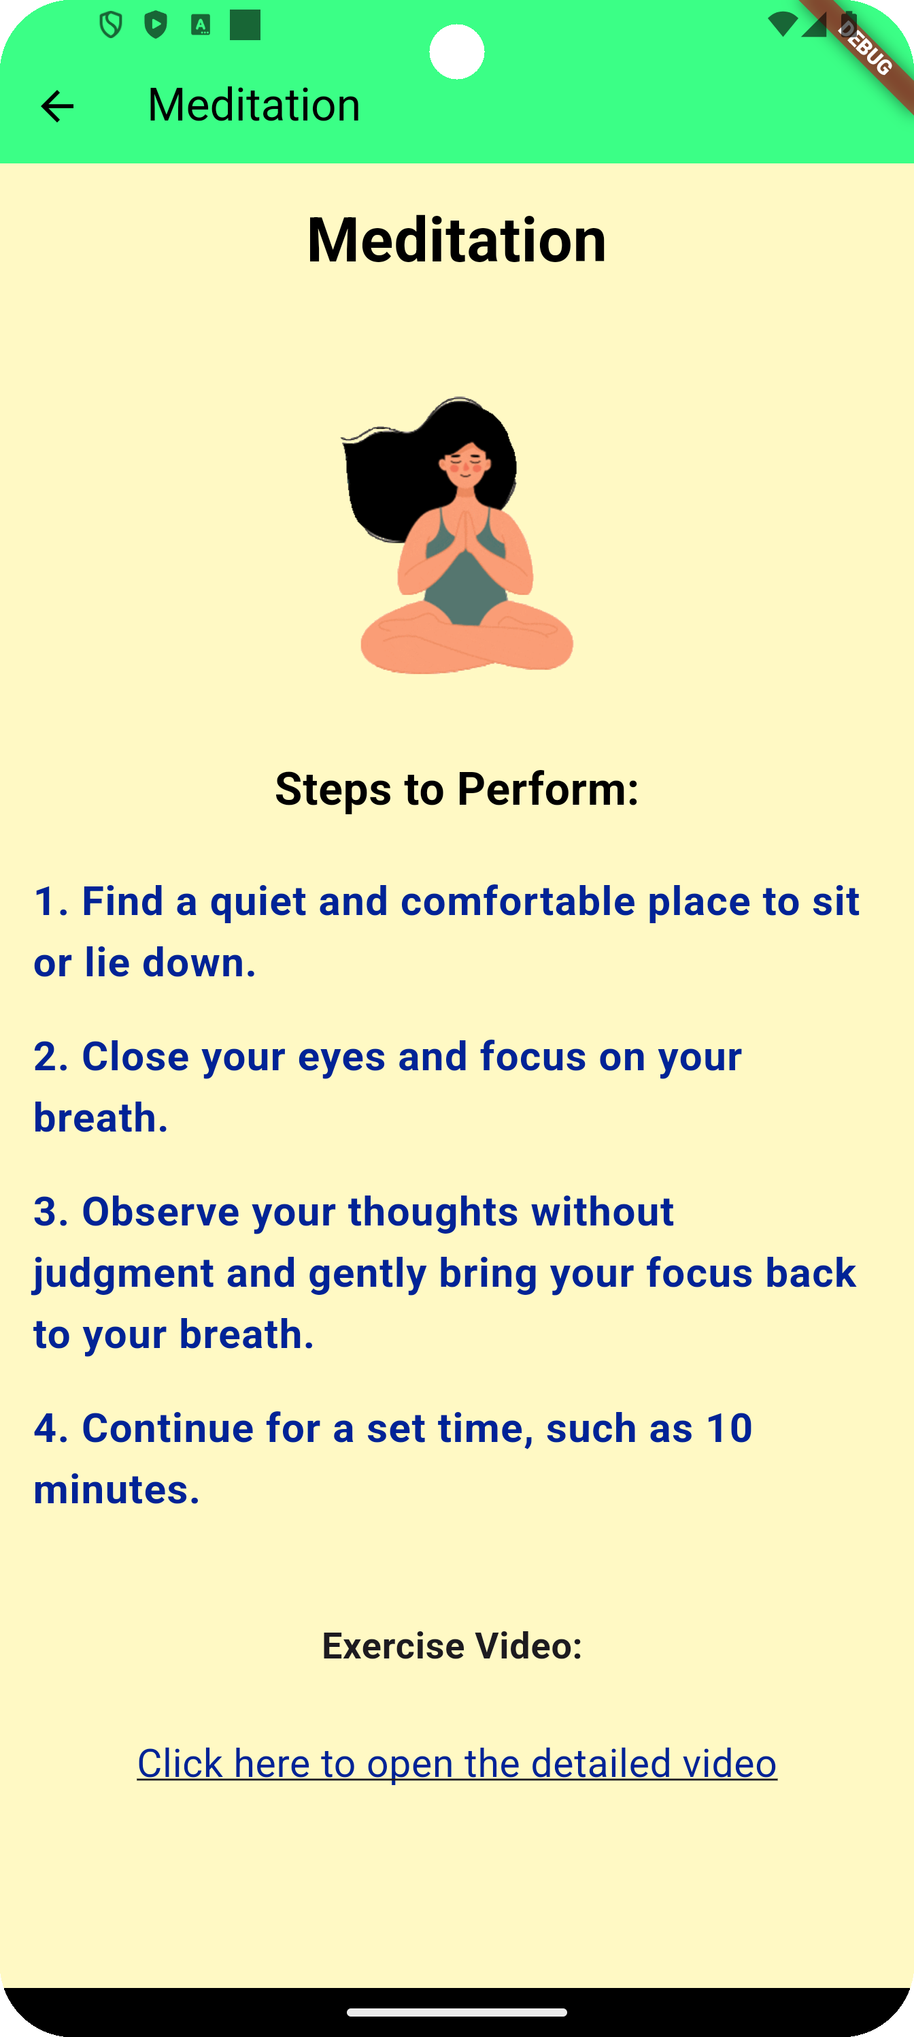
Design – overview of the solution

Slide 9
Design - User interface
Case 1: User opens the application
Home Screen Introduction with App logo and Exercise menu
Pop-Up Daily Affirmations to promote positive thinking
Explore daily mindfulness content or other stress reduction exercises by clicking on the respective buttons.

Slide 10
Design - User interface
Case II : Navigate to a Guided Mindfulness Exercise
Users can access mindfulness exercises by clicking on the "Mindfulness exercises" button on the home screen.
They are offered to choose from a list of mindfulness exercises.
Users then follow a guided exercise, complete with detailed steps and related video content to enhance their mindfulness practice.
Upon completion, users have a smooth transition within the app to go back

Slide 11
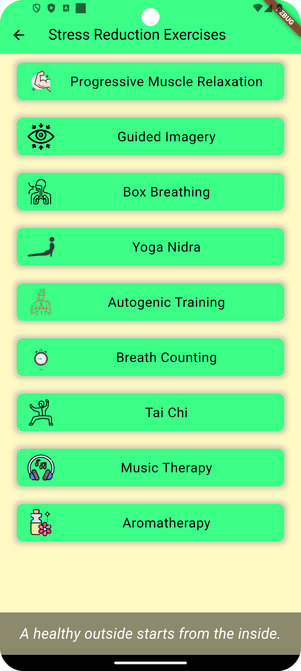
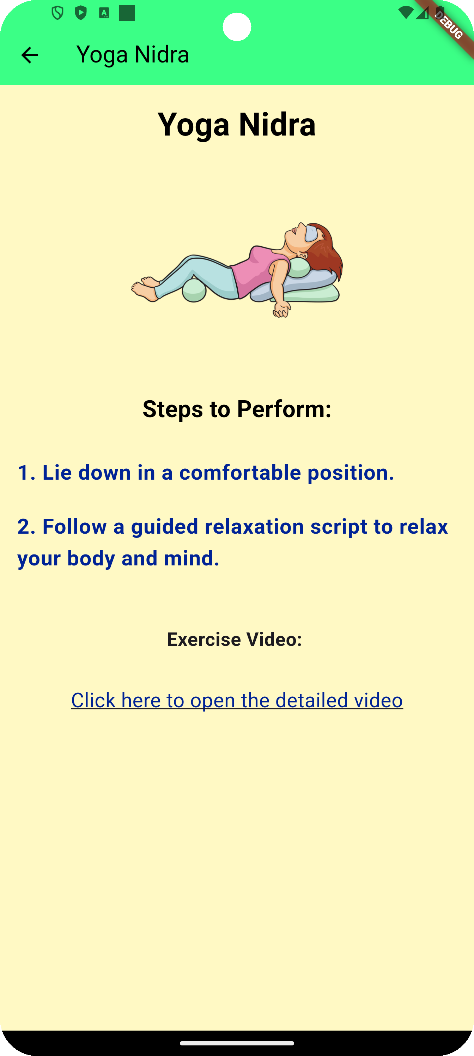
Design - User interface
Case III : Navigate to a Guided Stress Reduction Technique
Users can initiate a journey to reduce stress by clicking on the "Stress Reduction Techniques" button on the home screen.
Users have the freedom to select a stress reduction technique of their choice.
They then follow a guided technique, with clear steps to improve emotional resilience and reduce anxiety.
After completing the exercise, users can easily return to the techniques screen or the home screen, allowing them to tailor their stress reduction experience within Chillout Oasis.

Slide 12
Testing
We tested individual component of the application
01
Ensured smooth transitioning between the pages
02
Performed real world user testing and feedback
03
Tested across cross-platform to ensure compatibility
04
Checked the speed and performance of the app
05

Slide 13
YouTube link to video presentation:

Slide 14
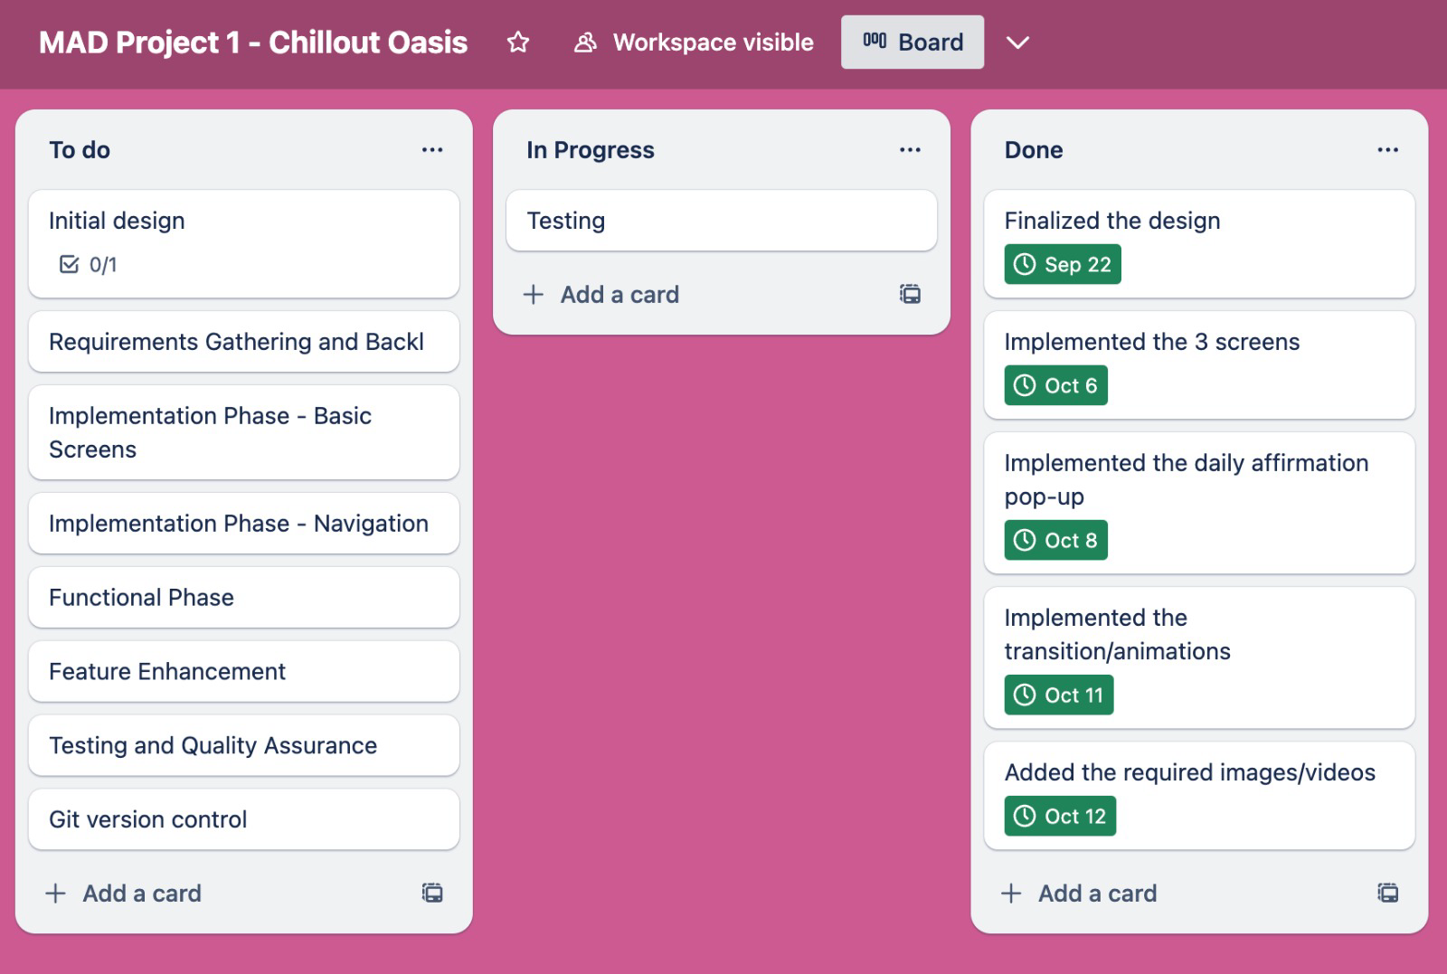

Kanban board
Calm Corner

Slide 15
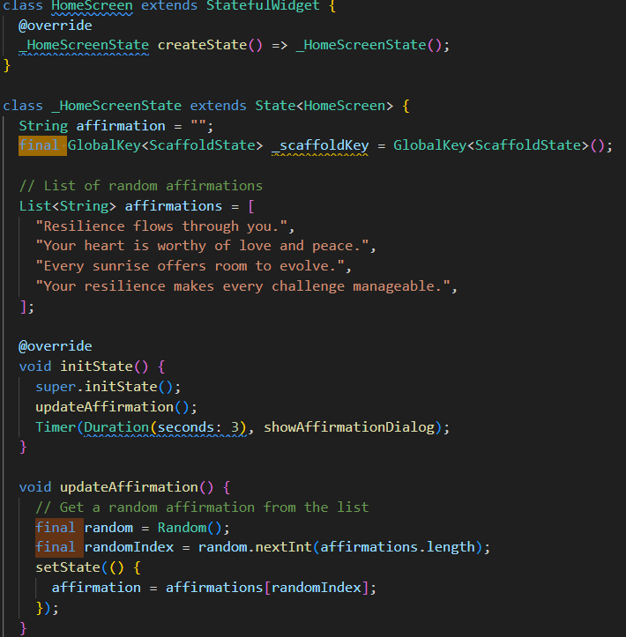
Code snippets- 1 transition/animations

Slide 16
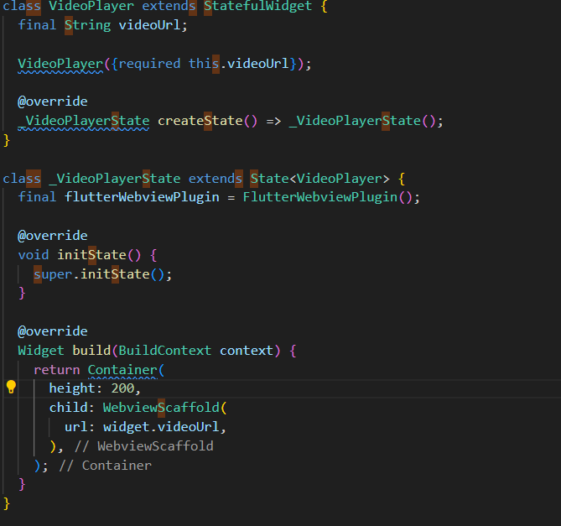
Code snippets- 2 transition/animations

Slide 17
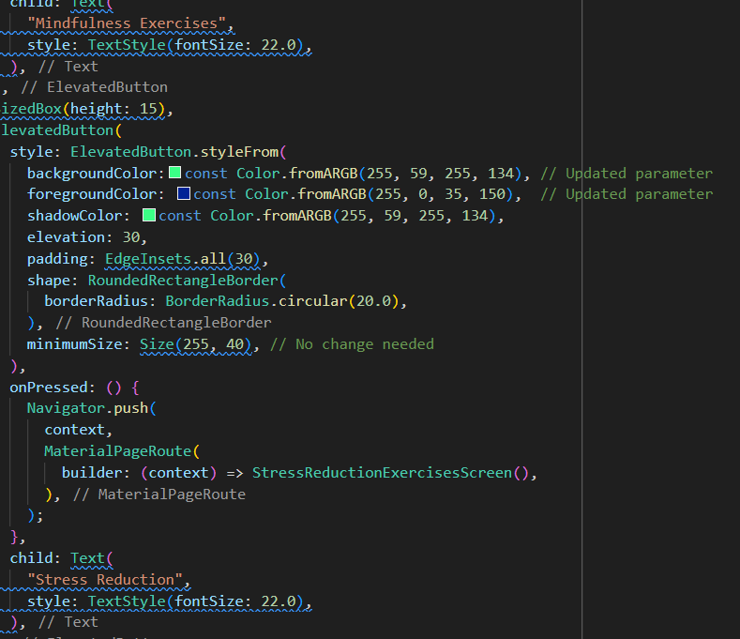
Code snippets- 3 transition/animations

Slide 18
Thanks!

